Slide 1
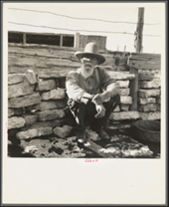
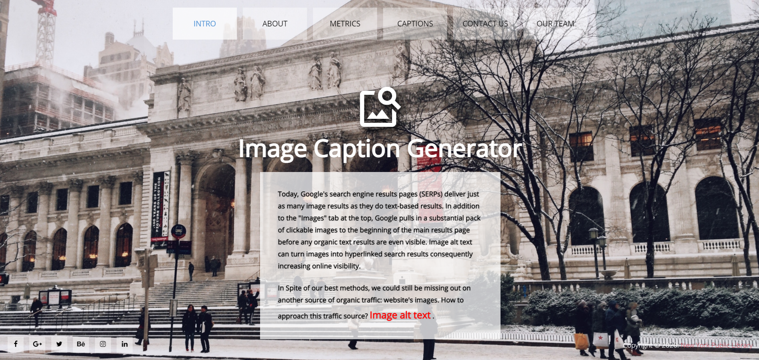
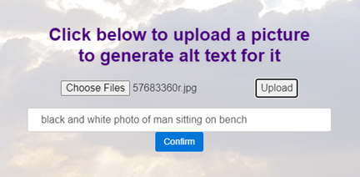
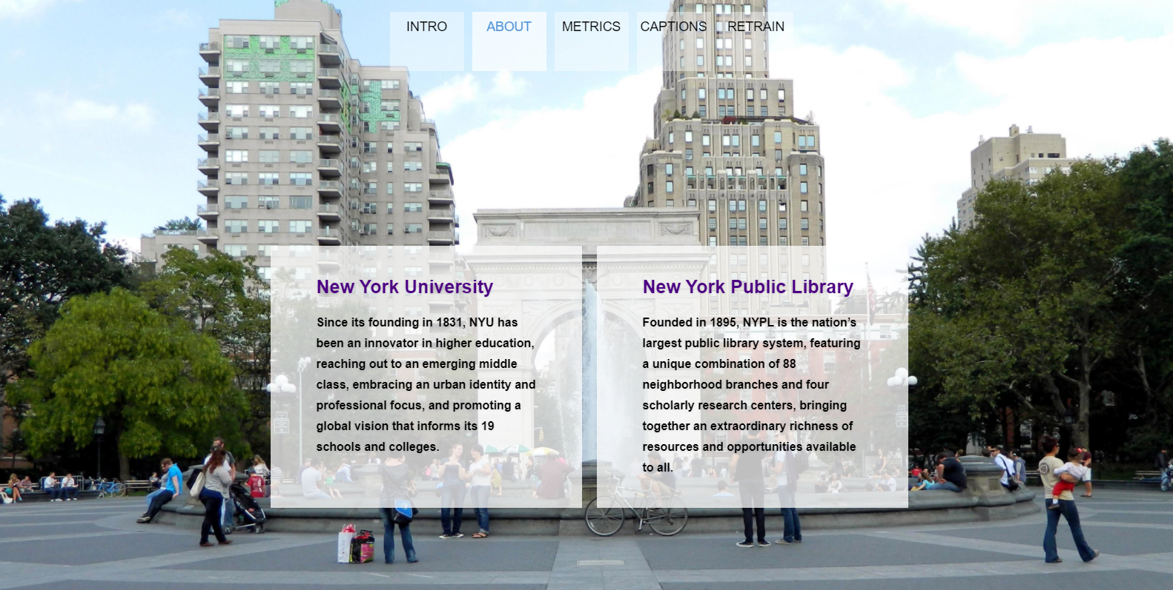


Solution Features
NYPL
Digital Collection Accessibility Solution
The alt text is generated from the image. The primary purpose of alt text is to describe the images (max 100 characters) to the website visitors who are unable to see the image and tell the search engine crawlers about the image. The alt text generated can also be corrected and the model can be retrained
Business Value
Automatically generating alt text reduces the amount of work required while adding images.
Images with optimized text are more likely to populate in image search queries.
Generating alt text for all the images will keep the site ADA (American Disability Act) compliant.
Alt tags provide better image context/descriptions to search engine crawlers, helping them to index an image properly.
Team:
Abhijeet Sant (ars1125@nyu.edu)
Nikita Amlani (nga261@nyu.edu)
Rohit Saraf (rs6785@nyu.edu)
Shreya Shreya (ss13337@nyu.edu)
Supervised by:
Pr , J.C. Franchitti (jcf@cs.nyu.edu)
Project Manager:
Sharon Denning (sharondenning@nypl.org)

Slide 2

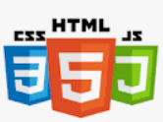
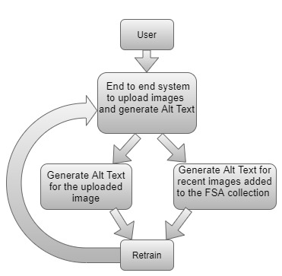
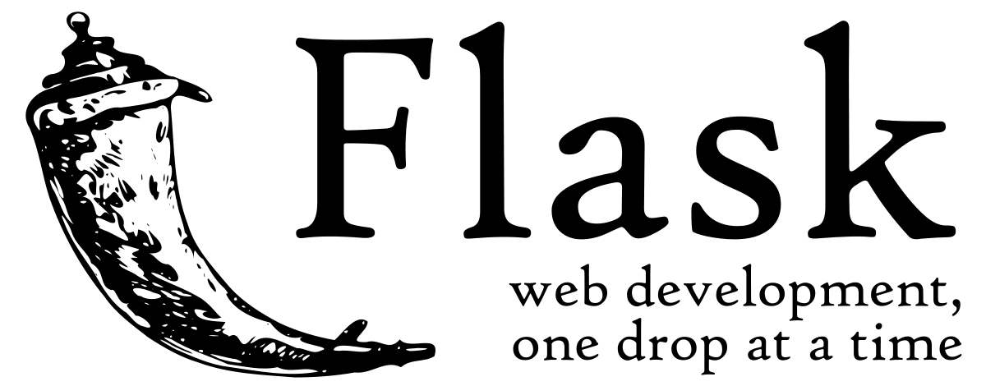
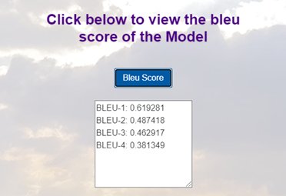


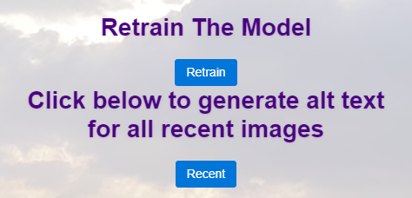
Objectives
Business Architecture
Technology Stack
NYPL has vast collection of 800k + digital assets which can be explored We built an end to end solution which enables a higher viewer base to enjoy the content provided by the library. Proposed design and implementation includes making the site more accessible by providing alt text functionality and a creating an accessible and interactive interface for the users.
Whenever a user wants to generate an alt text for an image or for recently added images in a collection, they can use the webpage (which internally uses a trained model) to generate the alt text for the uploaded image. The user can also make changes to the generated alt text and then retrain the model.
Our solution uses Bootstrap for the UI, Flask for backend services, HTML and CSS for the website, Jinja to generate Python template engine used to create HTML.
We trained our model based on the images and titles downloaded using the NYPL API .
Future Plan
There are currently several limitations in our solution implementation as follows:
The accuracy of our machine learning model is limited; the ML model should be retrained to generate the most appropriate alt text based on the image.
The current solution has to iterate over the whole collection to find newly added images, which takes a lot of time. A better solution needs to be discovered.
Creating a GUI for exploration search.
Currently our solution has been tested on FSA collection, the model should be trained and tested on other collections.
Current Implementation
Downloaded all the images of the Farm Security Administration, a collection of the Digital Collection of the New York Public Library.
We got 34436 images.
Created a python script which will get recent images added to the collection when run.
Used a machine learning model to generate captions.
Created a Python flask application which when run gives a few options to the users. One is to upload an image and generate its alt text, user can make changes to the Alt Text and retrain the model and run the model to generate alt text for all recent uploads in the FSA collection.
Current Solution Focus
Our current solution supports end to end system that can be used to generate alt text for the Farm Security Administration (FSA) collection.
The solution aligns with NYPL’s desire to keep the site accessible and ADA compliant.
The solution handles generating alt text for newly added images for the FSA collection.

